Slide 1
Introduction to Cloud Computing Unit 2- Day6-7 Deployment Models
Prashant Kaushal

Slide 2
Recap
Service Models (XaaS)
IaaS
PaaS
SaaS

Slide 3
Deployment Models
Different ways in which cloud computing environment can be setup
Most basic requirement
Properties of the cloud change
Business oriented
Correct model selection
Needs, requirements, budget and security
Wrong selection can be costly
No ‘one size fits all’
users are different

Slide 4
Deployment Models
Private Cloud
Public Cloud
Community Cloud
Hybrid Cloud

Slide 5
Deployment Models
Different ways in which cloud can be deployed
User centric
Based on users’ requirements and conveniences
Classification based on
Size, type of service provider, location, type of users, security, and other issues

Slide 6
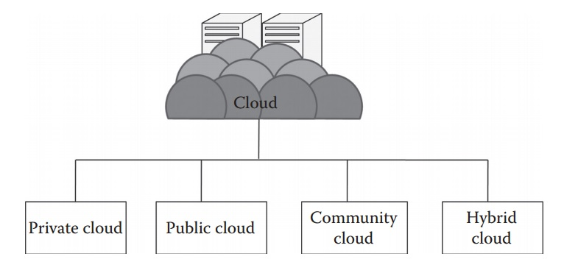
Deployment Models

Slide 7
Private Cloud
most basic deployment model that can be deployed by a single organization for its personal use
not shared by other organizations
not allowed for public use
to serve the people of an organization

Slide 8
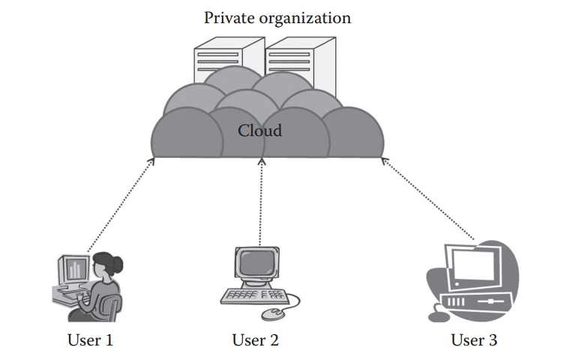
Private Cloud

Slide 9
Private Cloud
According to the National Institute of Standards and Technology (NIST), private cloud can be defined as the cloud infrastructure that is provisioned for exclusive use by a single organization comprising multiple consumers (e.g., business units). It may be owned, managed, and operated by the organization, a third party, or some combination of them, and it may exist on or off premises.

Slide 10
Private Cloud - Characteristics
Secure:
because usually the private cloud is deployed and managed by the organization itself, and hence there is least chance of data being leaked out of the cloud.
In the case of outsourced cloud, the service provider may view the cloud (though governed by SLAs), but there is no other risk from anybody else as all the users belong to the same organization.
Central control:
The organization mostly has full control over the cloud as usually the private cloud is managed by the organization itself.
when managed by the organization itself, there is no need for the organization to rely on anybody.
Weak SLAs:
Formal SLAs may or may not exist in a private cloud.
But if they exist they are weak as it is between the organization and the users of the same organization.
Thus, high availability and good service may or may not be available.
This depends on the organization that is controlling the cloud.

Slide 11
Private Cloud - Suitabilty
Suitability refers to the instances where this cloud model can be used.
It also signifies the most suitable conditions and environment where this cloud model can be used, such as the following: • The organizations or enterprises that require a separate cloud for their personal or official use. • The organizations or enterprises that have a sufficient amount of funds as managing and maintaining a cloud is a costly affair. • The organizations or enterprises that consider data security to be important. • The organizations that want autonomy and complete control over the cloud. • The organizations that have a less number of users. • The organizations that have prebuilt infrastructure for deploying the cloud and are ready for timely maintenance of the cloud for efficient functioning. • Special care needs to be taken and resources should be available for troubleshooting.

Slide 12
Private Cloud – Not suitable
The private cloud platform is not suitable for the following: • The organizations that have high user base • The organizations that have financial constraints • The organizations that do not have prebuilt infrastructure • The organizations that do not have sufficient manpower to maintain and manage the cloud

Slide 13
Private Cloud
According to NIST, the private cloud can be classified into several types based on their location and management: • On-premise private cloud • Outsourced private cloud

Slide 14
Private Cloud - Onpremise
On-premise private cloud is a typical private cloud that is managed by a single organization.
the cloud is deployed in organizational premises and is connected to the organizational network.

Slide 15
Private Cloud - Onpremise
Considerations
SLA
Network
Performance
Security and data privacy
Location
Cloud management
Multitenancy
Maintenance

Slide 16
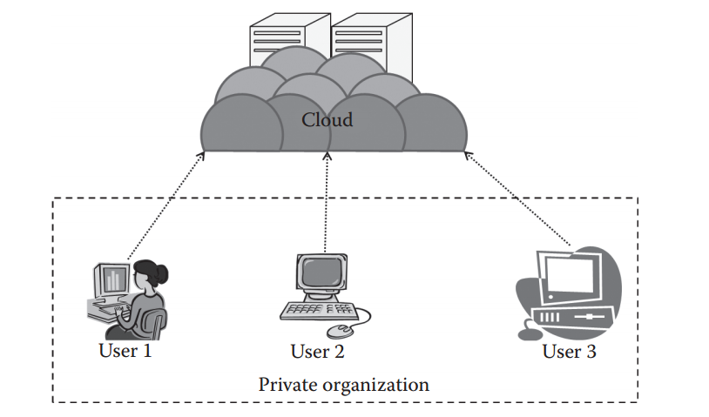
Private Cloud - Outsourced

Slide 17
Private Cloud - Outsourced
The outsourced private cloud has a cloud outsourced to a third party.
A third party manages the whole cloud.
Everything is same as usual private cloud except that here the cloud is outsourced.

Slide 18
Private Cloud - Outsourced
Considerations
SLA
Network
Performance
Security and data privacy
Location
Cloud management
Multitenancy
Maintenance

Slide 19
Private Cloud
Advantages
The cloud is small in size and is easy to maintain.
It provides a high level of security and privacy to the user.
It is controlled by the organization.
Disadvantages
For the private cloud, budget is a constraint.
The private clouds have loose SLAs.

Slide 20
Private Cloud - Deployments
small in size as compared to other cloud models
deployed using Opensource tools such as Openstack, Eucalyptus
To experience a real cloud, the private cloud can be used. The minimum configuration varies for each type of platforms, but in general, a machine with an 8 GB RAM, 250 GB hard disk, and at least an i7 processor will allow the user to install a private cloud in it. Further, this private (Infrastructure-as-a-Service [IaaS]) cloud can be used to create a virtual machine, and then a user can test these virtual machines. Based on the configuration, the efficiency of the cloud varies. This deployment may not offer a full-fledged private cloud for several users but can be very useful to understand the working of a private cloud.

Slide 21
Public Cloud
The opposite of the private cloud
access from any place in the world and is open to the public
biggest in size among all other deployment models
one of the most popular deployment models
public cloud service provider charges the users on an hourly basis
serve the users according to the service-level agreements (SLAs)

Slide 22
Public Cloud
According to NIST, the public cloud is the cloud infrastructure that is provisioned for open use by the general public.
It may be owned, managed, and operated by a business, academic, or government organization, or some combination of them.
It exists on the premises of the cloud provider.

Slide 23
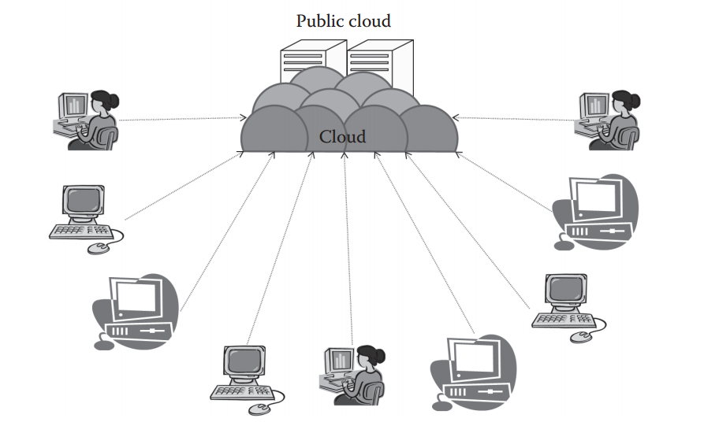
Public Cloud

Slide 24
Public Cloud
consists of users from all over the world
A user can simply purchase resources on an hourly basis and work with the resources
There is no need of any prebuilt infrastructure for using the public cloud.
These resources are available in the cloud provider’s premises
Theoretically infinite
Egs: Amazon AWS, Microsoft Azure, etc

Slide 25
Public Cloud - Characteristics
Highly scalable
Affordable
Less secure
Highly available
Stringent SLAs

Slide 26
Public Cloud - Suitability
• The requirement for resources is large, that is, there is large user base. • The requirement for resources is varying. • There is no physical infrastructure available. • An organization has financial constraints.

Slide 27
Public Cloud – Not Suitable
• Security is very important. • Organization expects autonomy. • Third-party reliability is not preferred

Slide 28
Public Cloud - Considerations
SLA
Network
Performance
Security and data privacy
Location
Cloud management
Multitenancy
Maintenance

Slide 29
Public Cloud - Advantages
Advantages • There is no need of establishing infrastructure for setting up a cloud. • There is no need for maintaining the cloud. • They are comparatively less costly than other cloud models. • Strict SLAs are followed. • There is no limit for the number of users. • The public cloud is highly scalable. Disadvantages • Security is an issue. • Privacy and organizational autonomy are not possible.

Slide 30
Community Cloud
an extension of the private cloud
shared by several organizations
established for a common cause
cause can be anything,
but usually it leads to mutual benefits among the participating organizations

Slide 31
Community Cloud
According to NIST, the community cloud is the cloud infrastructure that is provisioned for exclusive use by a specific community of consumers from organizations that have shared concerns (e.g., mission, security requirements, policy, and compliance considerations).
It may be owned, managed, and operated by one or more of the organizations in the community, a third party, or some combination of them, and it may exist on or off premises

Slide 32
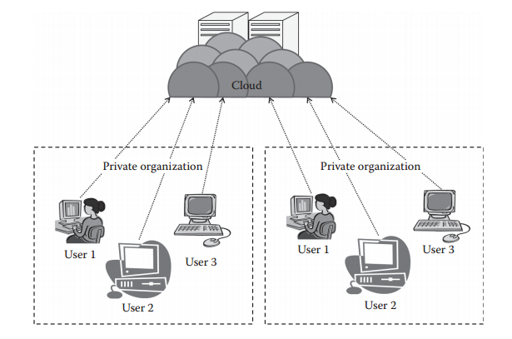
Community Cloud

Slide 33
Community Cloud - Characteristics
Collaborative and distributive maintenance
Partially secure
Cost effective

Slide 34
Community Cloud - Suitability
• Want to establish a private cloud but have financial constraint • Do not want to complete maintenance responsibility of the cloud • Want to establish the cloud in order to collaborate with other clouds • Want to have a collaborative cloud with more security features than the public cloud
This cloud is not suitable for organizations that • Prefer autonomy and control over the cloud • Does not want to collaborate with other organizations

Slide 35
Community Cloud - Considerations
SLA
Network
Performance
Security and data privacy
Location
Cloud management
Multitenancy
Maintenance

Slide 36
Community Cloud - Advantages
Advantages • It allows establishing a low-cost private cloud. • It allows collaborative work on the cloud. • It allows sharing of responsibilities among the organization. • It has better security than the public cloud.
Disadvantages • Autonomy of an organization is lost. • Security features are not as good as the private cloud. • It is not suitable if there is no collaboration

Slide 37
Hybrid Cloud
combination of other deployments
Usually, it consists of the private and public clouds combined.
Several properties of the private cloud are used with the properties of the public cloud.
This cloud is one of the upcoming cloud models growing in the industry.

Slide 38
Hybrid Cloud
According to NIST, the hybrid cloud can be defined as the cloud infrastructure that is a composition of two or more distinct cloud infrastructures (private, community, or public) that remain unique entities but are bound together by standardized or proprietary technology that enables data and application portability
Usually a combination of public and private cloud

Slide 39
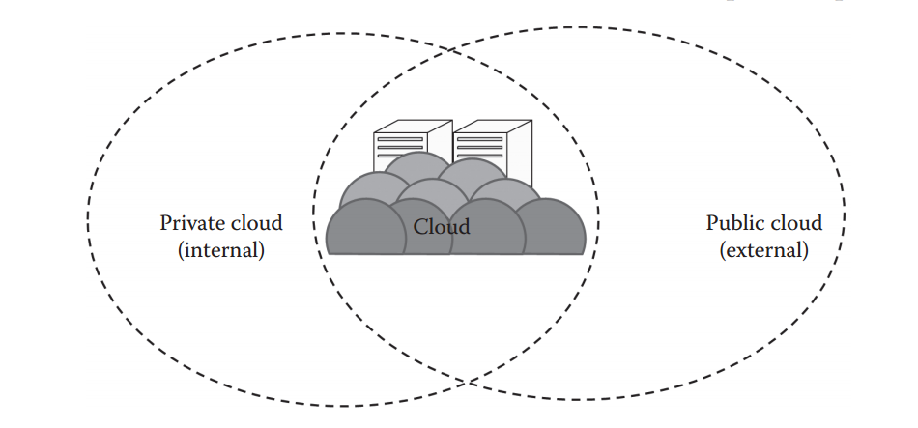
Hybrid Cloud

Slide 40
Hybrid Cloud - Characteristics
Scalable
Partially secure
Stringent SLAs
Complex cloud management

Slide 41
Hybrid Cloud - Suitability
The hybrid cloud environment is suitable for • Organizations that want the private cloud environment with the scalability of the public cloud • Organizations that require more security than the public cloud
The hybrid cloud is not suitable for • Organizations that consider security as a prime objective • Organizations that will not be able to handle hybrid cloud management

Slide 42
Hybrid Cloud - Considerations
SLA
Network
Performance
Security and data privacy
Location
Cloud management
Multitenancy
Maintenance

Slide 43
Hybrid Cloud
Advantages • It gives the power of both the private and public clouds. • It is highly scalable. • It provides better security than the public cloud.
Disadvantages • The security features are not as good as the public cloud. • Managing a hybrid cloud is complex. • It has stringent SLAs.

Slide 44
Unit2 - SelfStudy
Unit 1 -> Pick up any SaaS provider and study its architecture
For eg FlipKart, OlaCabs, Uber etc
Look at stackshare.io
Unit 2 ->
For the SaaS solution under study, evaluate whether a cloud solution is being used and if yes, how it is being used?

Slide 45
Thanks

